Slide 1
Java Fundamentals

Slide 2
Variable Assignment and Initialization
In order to store a value in a variable, an assignment statement must be used.
The assignment operator is the equal (=) sign.
The operand on the left side of the assignment operator must be a variable name.
The operand on the right side must be either a literal or expression that evaluates to a type that is compatible with the type of the variable.

Slide 3
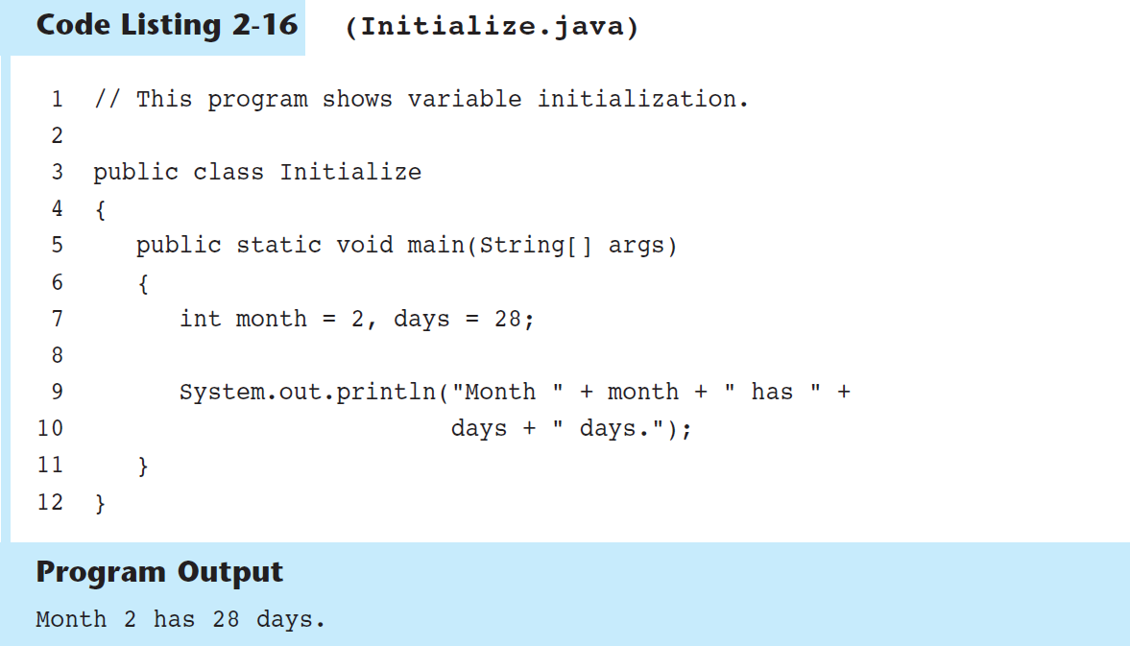

Slide 4
Variable Assignment and Initialization (cont’d.)
Variables can only hold one value at a time.
Local variables do not receive a default value.
Local variables must have a valid type in order to be used.

Slide 5
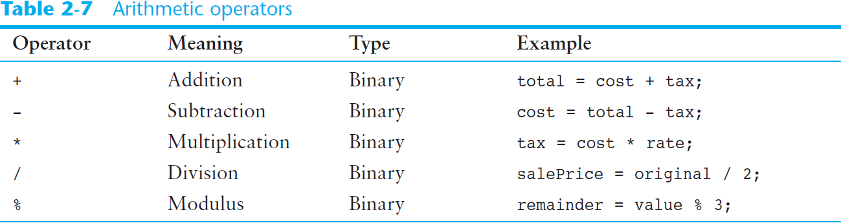
Arithmetic Operators

Slide 6
Arithmetic Operators (cont’d.)
The operators are called binary operators because they must have two operands.
Each operator must have a left and right operand.
The arithmetic operators work as one would expect.
It is an error to try to divide any number by zero.
When working with two integer operands, the division operator requires special attention.

Slide 7
Integer Division
Division can be tricky.
In a Java program, what is the value of 1/2?
You might think the answer is 0.5…
But, that’s wrong.
The answer is simply 0.
Integer division will truncate any decimal remainder.

Slide 8
Operator Precedence
Mathematical expressions can be very complex.
There is a set order in which arithmetic operations will be carried out.
Operator | Associativity | Example | Result
- (unary negation) | right to left | x = -4 + 3; | -1
* / % | left to right | x = -4 + 4 % 3 * 13 + 2; | 11
+ - | left to right | x = 6 + 3 – 4 + 6 * 3; | 23
Higher
Priority
Lower
Priority

Slide 9
Grouping with Parenthesis
When parenthesis are used in an expression, the inner most parenthesis are processed first.
If two sets of parenthesis are at the same level, they are processed left to right.
x = ((4*5) / (5-2) ) – 25; // result = -19
3
1
2
4

Slide 10
The Math Class
The Java API provides a class named Math, which contains several methods that are useful for performing complex mathematical operations.
In Java, raising a number to a power requires the Math.pow method
double result = Math.pow(4.0, 2.0);
The Math.sqrt method accepts a double value as its argument and returns the square root of the value
double result = Math.sqrt(9.0);

Slide 11
Combined Assignment Operators
Java has some combined assignment operators.
These operators allow the programmer to perform an arithmetic operation and assignment with a single operator.
Although not required, these operators are popular since they shorten simple equations.

Slide 12
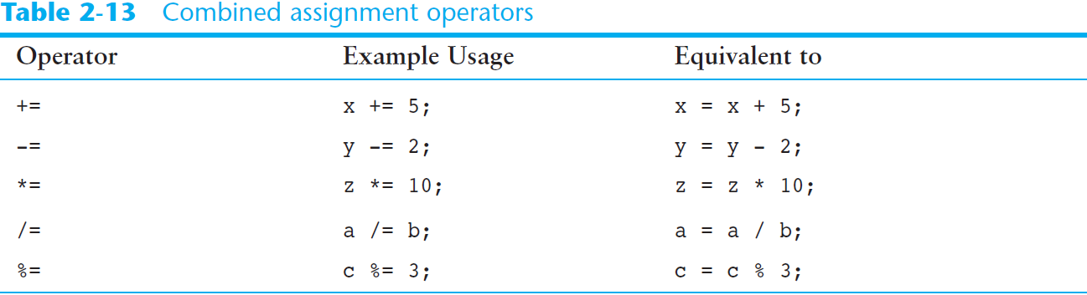
Combined Assignment Operators (cont’d.)

Slide 13
Conversion between Primitive Data Types
Java is a strongly typed language.
Before a value is assigned to a variable, Java checks the data types of the variable and the value being assigned to it to determine if they are compatible.
When you try to assign an incompatible value to a variable, an error occurs at compile-time.

Slide 14
Conversion between Primitive Data Types (cont’d.)
For example, look at the following statements:
int x;
double y = 2.5;
x = y;
This statement will cause a compiler error because it is trying to assign a double value (2.5) in an int variable.

Slide 15

Conversion between Primitive Data Types (cont’d.)
The Java primitive data types are ranked, as shown here:

Slide 16
Conversion between Primitive Data Types (cont’d.)
Widening conversions are allowed.
This is when a value of a lower-ranked data type is assigned to a variable of a higher-ranked data type. This is allowed.
Example:
double x;
int y = 10;
x = y;
Widening Conversion

Slide 17
Conversion between Primitive Data Types (cont’d.)
Narrowing conversions are not allowed.
This is when a value of a higher-ranked data type is assigned to a variable of a lower-ranked data type. This is not allowed.
Example:
int x;
double y = 2.5;
x = y;
Narrowing Conversion

Slide 18
Conversion between Primitive Data Types (cont’d.)
Cast Operators
Lets you manually convert a value, even if it means that a narrowing conversion will take place.
Example: converting a double to an int
int x;
double y = 2.5;
x = (int)y;
Cast Operator

Slide 19
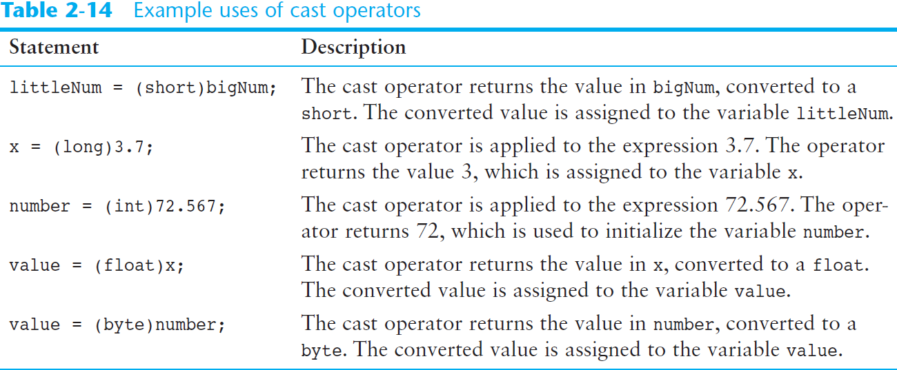
Conversion between Primitive Data Types (cont’d.)

Slide 20
Conversion between Primitive Data Types (cont’d.)
Mixed Integer Operations
When values of the byte or short data types are used in arithmetic expressions, they are temporarily converted to int values.
The result of an arithmetic operation using only a mixture of byte, short, or int values will always be an int.

Slide 21
Conversion between Primitive Data Types (cont’d.)
Mixed Integer Operations
For example:
short a;
short b = 3;
short c = 7;
a = b + c;
a = (short)(b + c);
This statement will cause an error because the result of b + c is an int. It cannot be assigned to a short variable.
To fix the statement, rewrite the
expression using a cast operator.

Slide 22
Conversion between Primitive Data Types (cont’d.)
Other Mixed Mathematical Expressions
If one of an operator’s operands is a double, the value of the other operand will be converted to a double.
The result of the expression will be a double.
If one of an operator’s operands is a float, the value of the other operand will be converted to a float.
The result of the expression will be a float.
If one of an operator’s operands is a long, the value of the other operand will be converted to a long.
The result of the expression will be a long.

Slide 23
Creating Named Constants with final
Many programs have data that does not need to be changed.
Littering programs with literal values can make the program hard do read and maintain.
Replacing literal values with constants remedies this problem.
Constants allow the programmer to use a name rather than a value throughout the program.
Constants also give a singular point for changing those values when needed.

Slide 24
Creating Named Constants with final (cont’d.)
Constants keep the program organized and easier to maintain.
Constants are identifiers that can hold only a single value.
Constants are declared using the keyword final.
Constants need not be initialized when declared; however, they must be initialized before they are used or a compiler error will be generated.

Slide 25
Creating Named Constants with final (cont’d.)
Once initialized with a value, constants cannot be changed programmatically.
By convention, constants are all upper case and words are separated by the underscore character.
For example:
final double CAL_SALES_TAX = 0.0725;

Slide 26
The String Class
Java has no primitive data type that holds a series of characters.
The String class from the Java standard library is used for this purpose.
In order to be useful, the a variable must be created to reference a String object.
String number;
Notice the S in String is upper case.
By convention, class names should always begin with an upper case character.

Slide 27
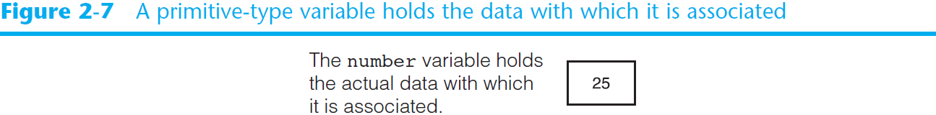
Primitive-Type Variables and Class-Type Variables
Primitive variables actually contain the value that they have been assigned.
int number = 25;
The value 25 will be stored in the memory location associated with the variable number.
Objects are not stored in variables, however. Objects are referenced by variables.

Slide 28
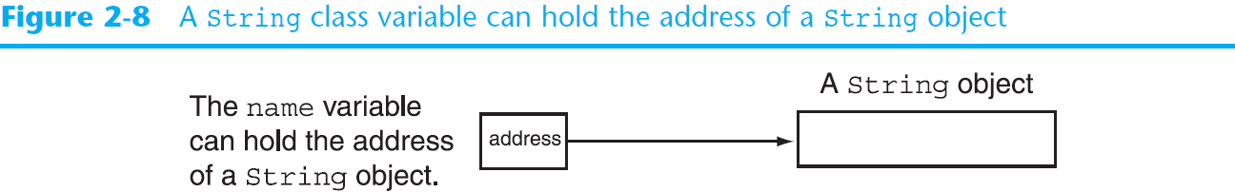
Primitive-Type Variables and Class-Type Variables (cont’d.)
When a variable references an object, it contains the memory address of the object’s location.
Then it is said that the variable references the object.
String name = “Nekesa Wafula";

Slide 29
Creating a String Object
A variable can be assigned a string literal.
String value = "Hello";
String objects are the only objects that can be created in this way.
An object can be created using the new keyword.
String value = new String("Hello");
This is the method that all other objects must use when they are created.

Slide 30
Creating a String Object (cont’d.)
Since String is a class, objects that are instances of it have methods.
One of those methods is the length method.
int stringSize = value.length();
This statement calls the length method on the object pointed to by the value variable
The String class contains many methods that help with the manipulation of String objects.

Slide 31
Scope
Scope refers to the part of a program that has access to a variable’s contents.
Variables declared inside a method (like the main method) are called local variables.
The scope of a local variable begins at the declaration of the variable and ends at the end of the method in which it was declared.

Slide 32
Comments
Comments are:
notes of explanation that document lines or sections of a program.
part of the program, but the compiler ignores them.
intended for people who may be reading the source code.
In Java, there are three types of comments:
Single-line comments
Multiline comments
Documentation comments

Slide 33
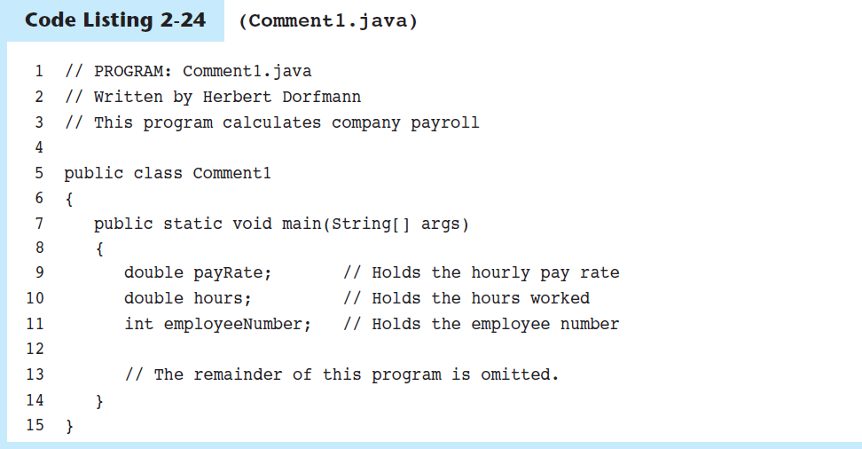
Single-Line Comments
Place two forward slashes (//) where you want the comment to begin.
The compiler ignores everything from that point to the end of the line.

Slide 34
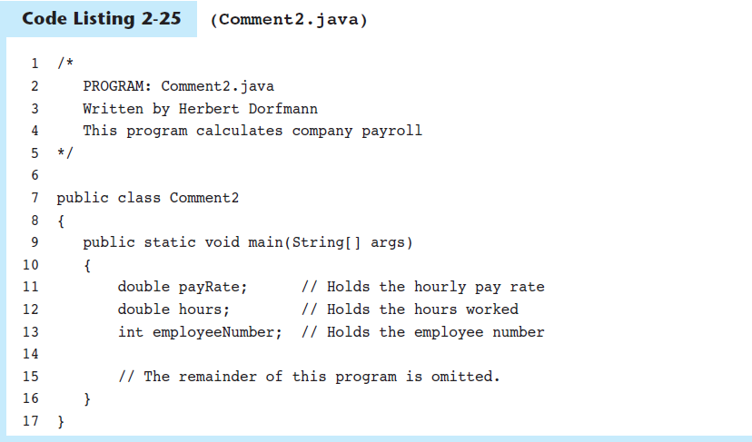
Multiline Comments
Start with /* (a forward slash followed by an asterisk) and end with */ (an asterisk followed by a forward slash).
Everything between these markers is ignored.
Can span multiple lines

Slide 35
Programming Style
Programming style refers to the way a programmer visually arranges a program’s source code.
When the compiler reads a program it:
Processes it as one long stream of characters.
Doesn’t care that each statement is on a separate line, or that spaces separate operators from operands.
Humans, on the other hand, find it difficult to read programs that aren’t written in a visually pleasing manner.

Slide 36
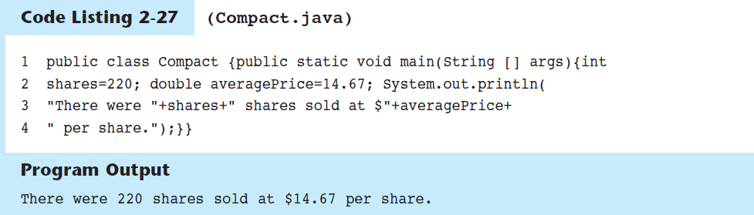
Programming Style (cont’d.)

Slide 37
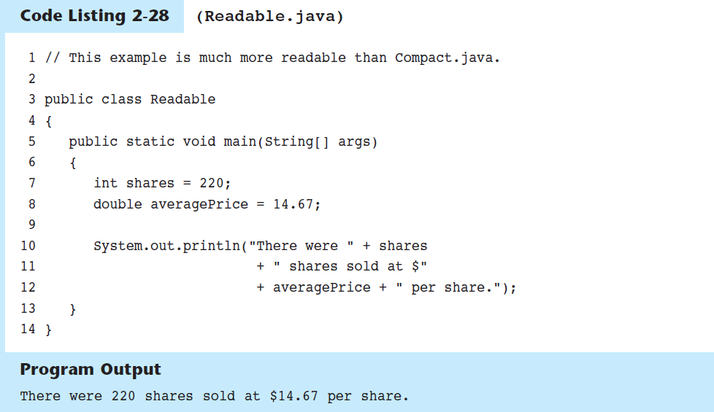
Programming Style (cont’d.)

Slide 38
END

